Slide 1
Open-Source Dynamic Traffic Assignment Package
DTALite/NEXTA
Xuesong (Simon) Zhou
xzhou99@gmail.com
xzhou74@asu.edu

Slide 2
Outline
Module 1: Introduction to DTALite/NeXTA
Module 2: Introduction to DTA modelling principles
Module 3: Visualization Features in NeXTA
Module 4: Introduction to Workshop Exercises
2
Notes:
As I just mentioned, the webinar is divided into four parts, referring to four separate videos which make up this recorded session. This is the first session, where we’ll introduce you to DTALite and NeXTA, and provide an overview of our project development so far.

Slide 3
Module 1 Introduction to DTALite/NeXTA
1.1 Project Objective and Motivations
1.2 What NeXTA/DTALite Can Do
1.3 Open-source Free Software Package

Slide 4
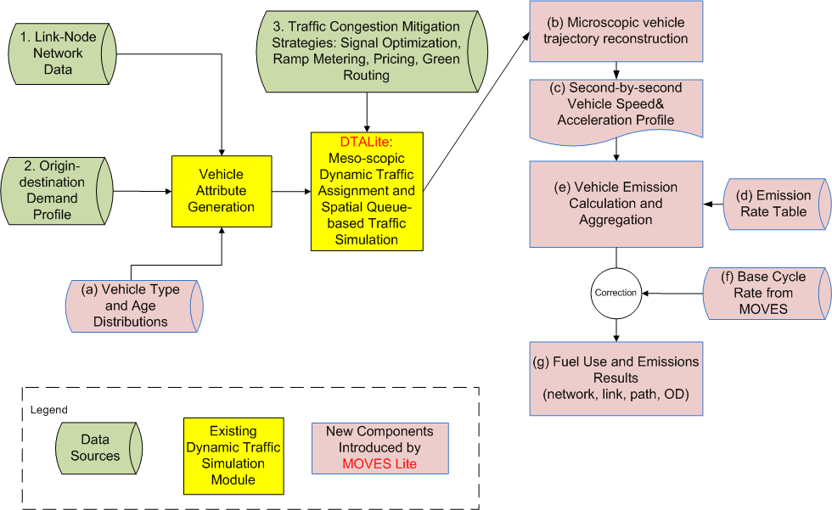
System Architecture and Data Flow
Data or progress | Corresponding functions or class
Link-Node Network Data | Class :Node(),Link() Functions: g_read_input_data()
Origin-destination Demand Profile | Class :Agent() Functions: g_read_input_data()
DTALite:Meso-scopic Dynamic Traffic Assignment and Spatial Queue-based Traffic Simulation | Class :Network() Functions: g_traffic_assignment() g_traffic_simulation()

Slide 5
Illustration of N-Curve Computation For Tracking Queue Spillback

Slide 6
Simulation Logic as Simple Queue
Can be viewed as pseudo event-based simulation and we do not simulate how a vehicle moves inside the link
Vehicle is moved into an in-flow queue at time t_{a}
Calculate time entering the out-flow queue as t_{a}+FFTT (free-flow travel time)
If the current simulation time t equals to or is later than t_{a}+FFTT, if the link out capacity is still available, move this vehicle to the next link, otherwise stay in the out-flow queue
Item | Corresponding variables
FFTT | link.free_flow_travel_time_in_min
In-flow queue | link.entrance_queue
Out-flow queue | link.exit_queue
Out –flow
Queue
Available capacity
at every simulation interval
In-flow Queue
Notes:
How to Determine Link-In Capacity at Each Simulation Interval
Free-flow or partially congested → use pre-specified reduced capacity
Fully congested according to N-Curve formula
--> Link-out flow rate from the previous simulation interval
How to Determine Link-Out Capacity at Each Simulation Interval
Minimal of the following elements
Pre-specified Average Capacity
If a link is fully congested, its link-in capacity will be distributed to incoming links as function of lanes

Slide 7
Module 2 Introduction to DTA modelling principles
2.1 Dynamic Traffic Assignment Modelling Framework
2.2 Agent-based Routing
2.3 VOT Distribution
2.4 Multiple Traffic Simulation Models

Slide 8
2.1 DTA Modelling Framework
Item | Corresponding functions or steps
Link Traversal | step 2.3 in g_traffic_simulation()
Node Transfer | step 2.4 in g_traffic_simulation()
Path processing | Network.optimal_label_correcting( )
User decision | Network. find_path_for_agents()
8
Notes:
In general, the traffic simulation assigns vehicles to different paths based upon link travel time. The physical process of moving vehicles works in a two-step process. First, a vehicle is moved across a link during the link pass, and then moved between links at the node during the node pass. Link travel times from the traffic simulator are fed to the shortest path model for path selection. The new paths are then fed back into the traffic simulator in the next iteration.

Slide 9
2.4 Multiple Traffic Simulation Models
Newell’s simplified kinematic wave model
Item | Corresponding variables
Outflow capacity | Link.td_link_outflow_capacity[]
Entrance List | Link. entrance_queue
Exit Queue | Link. exit_queue
Outflow capacity
Inflow capacity
Storage capacity
Exit Queue
Entrance List
Inflow Capacity
Outflow Capacity
Storage Capacity
9

Slide 10
2.4 MultipleTraffic Simulation Models
Item | Corresponding variables
Outflow capacity | Link.td_link_outflow_capacity[]
Entrance List | Link. entrance_queue
Exit Queue | Link. exit_queue
Queue propagation
Inflow capacity = outflow capacity
Inflow Capacity
Outflow Capacity
10

Slide 11
2.4 Multiple Traffic Simulation Models
Item | Corresponding variables or functions
Outflow capacity | Link.td_link_outflow_capacity[]
Node transfer | step 2.4 in g_traffic_simulation()
Entrance List | Link. entrance_queue
Exit Queue | Link. exit_queue
Node transfer
Node Transfer
Node
Check Outflow Capacity
Check Inflow Capacity
Check Storage Capacity
11
Notes:
Going into more specifics, let’s take a closer look at the link pass and node pass. The capacity constraints are enforced at both ends of each link. At the beginning of the link, the entrance list keeps track of vehicles entering the link, enforcing the inflow capacity constraint. During the link pass, the vehicles are moved between the entrance list and the exit queue. The exit queue keeps track of vehicles waiting to leave the link, enforcing the outflow capacity constraint. Vehicles are then moved between the exit queue and the entrance list of the next link during the node.

Slide 12
2.4 Multiple Traffic Simulation Models
Merge Models
Distribute inflow capacity to upstream links
Lane & demand-based methods
80%
Node
Available Inflow Capacity
20%
12

Slide 13
2.4 Multiple Traffic Simulation Models
Diverge Models
Different conditions by lane
First-In-First-Out (FIFO) constraint
Relaxation to prevent extreme bottlenecks
Node
13

Slide 14
2.4 Multiple Traffic Simulation Models
Signalized Intersections
Effective green time, saturation flow rate, movement-based capacity
Relaxed inflow constraints
14

Slide 15
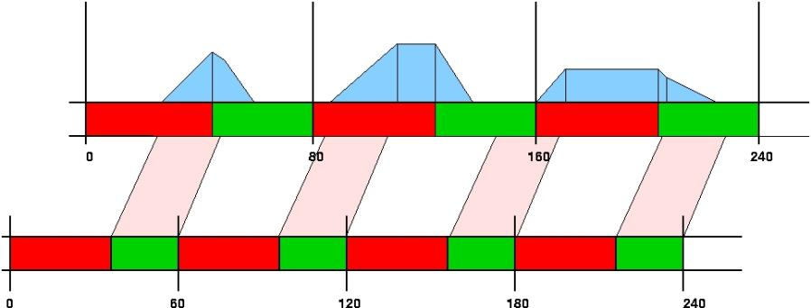
2.4 Multiple Traffic Simulation Models
Signal Timing & Hourly Capacity
Input: Average hourly capacity, cycle time, offset at node
Output: Effective green time per cycle(capacity/saturation flow rates)
15

